Slide 1
Tortuosity
BETA
A web based quiz for Geology students.
John Rugen, Louis, Gareth and Mohammed.

Slide 2
Recap
Tortuosity is a web app designed for Geology students participating in a quiz. Our client would like to host a quiz within her lessons and asked us to build a blockbusters type game.
The teacher would pull up the gameboard on her computer for the whole class to see.
The students then connect to the game, and once the teacher selects a question it gets pushed to the students phone. They can answer it from there.
It’s a knockout quiz, if you get a question wrong you are locked out from the session.

Slide 3
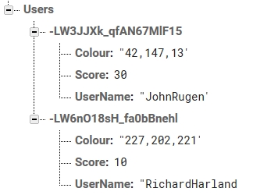
User Authentication
We needed a way to keep track of scores within the database. This allows statistics and other important values to be dynamically changed throughout the app.
Once a user creates an account, an account is then created through firebase.
Whilst the account gets created, a new field within the database gets created with a unique ID. That ID is then stored within the users account.
This unique ID field contains children that can store information. More children can be added during runtime and dynamically which allows for game rules to be added once the game is released.

Slide 4
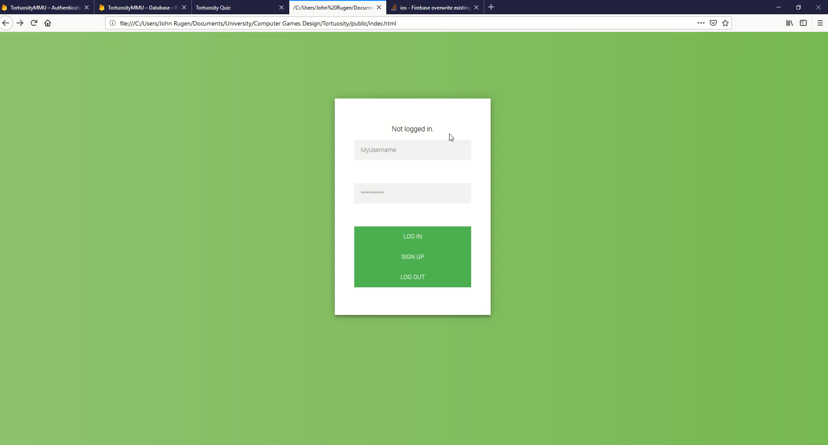
User Authentication

Slide 5
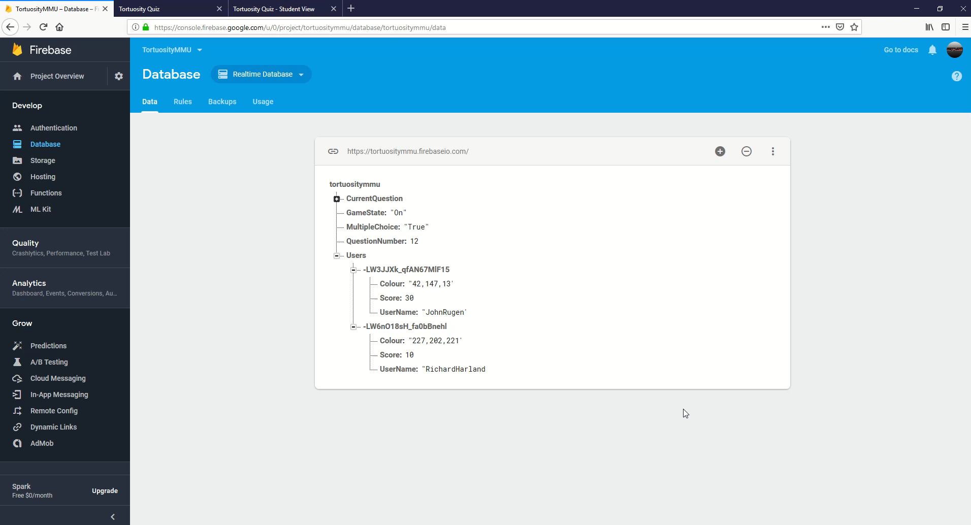
Leader boards

Slide 6
Bugs
Once a player connects to a game that has finished, they can’t answer questions or see the last question.
Once a game finishes, players are met with a correct end game screen & can’t answer questions.
Players can create accounts with the same user name.
End game screen not displaying correct information.
Users can answer questions after they’ve been knocked out, impacting their score.

Slide 7
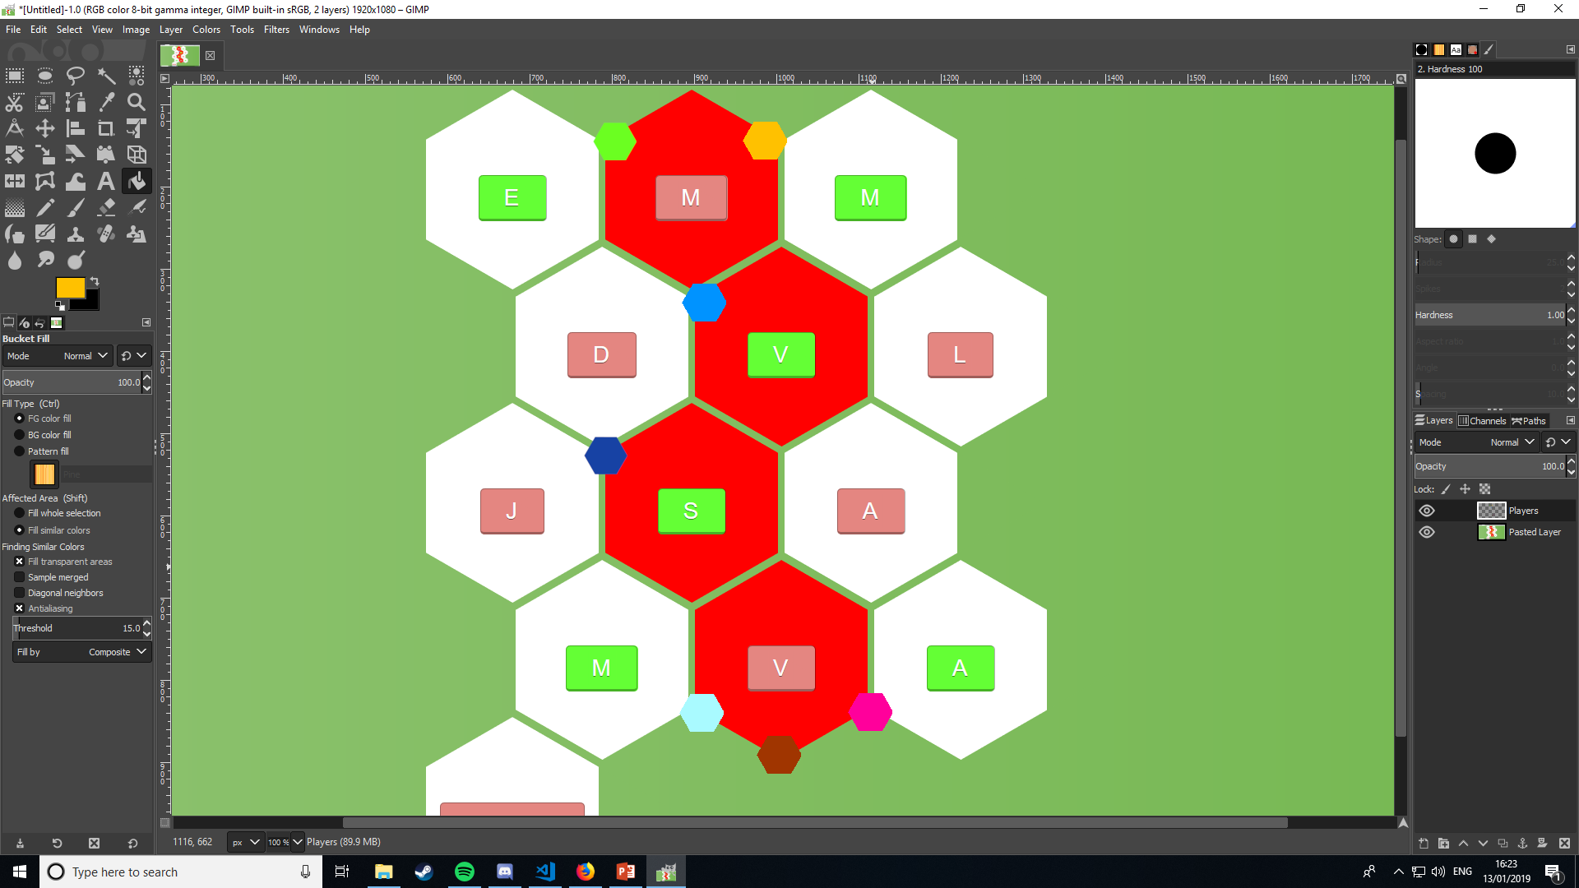
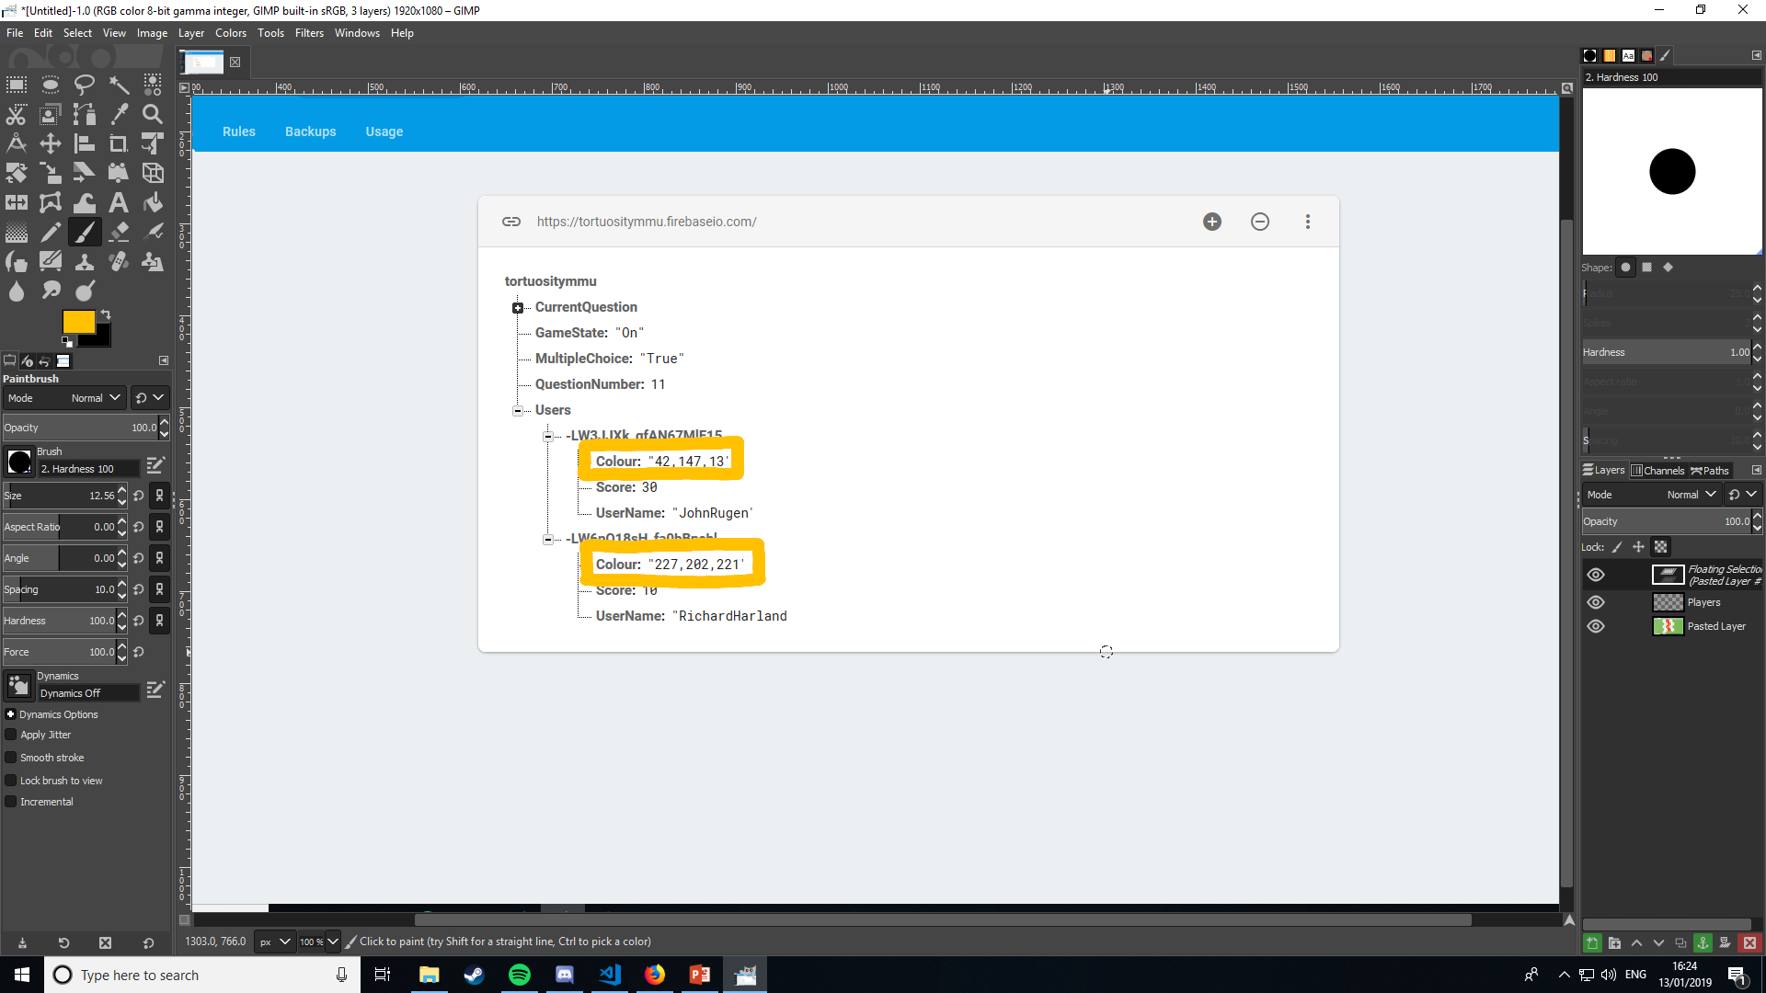
Client Feedback
Met with the client just before we broke up for Christmas. She was happy with the work so far, enjoyed playing a game. Decided on some extra functionality she’d like to see within the game:
Leader boards
Each user is assigned a colour and that is represented on the game board.

Slide 8
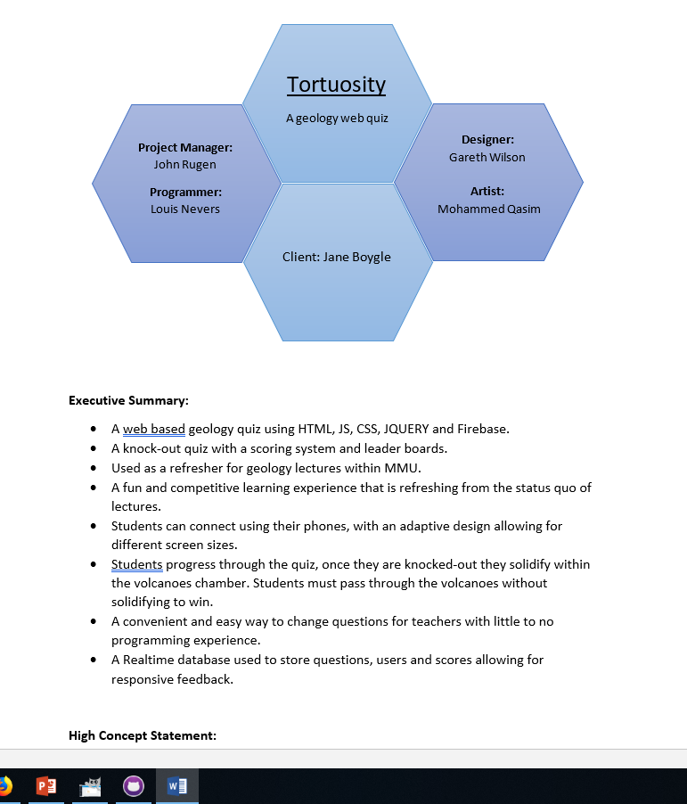
Treatment Design Document
More testing and work required.
Work in progress. The quiz uses a JSON file.

Slide 9
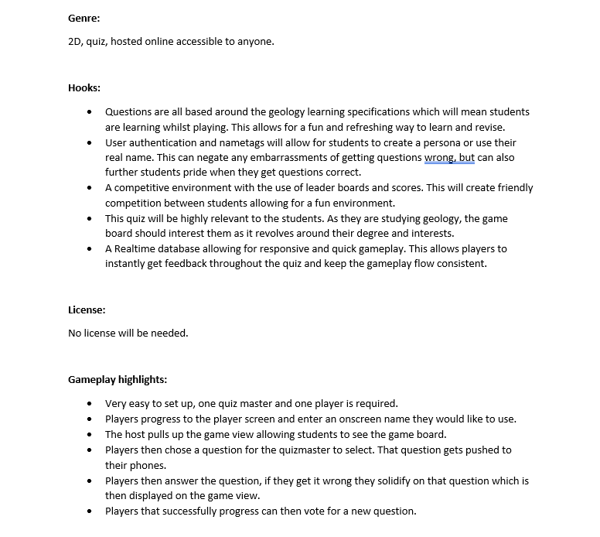
Treatment Design Document
Displayed via coloured hexagons in the game view, voting for a question is the next big development feature.

Slide 10
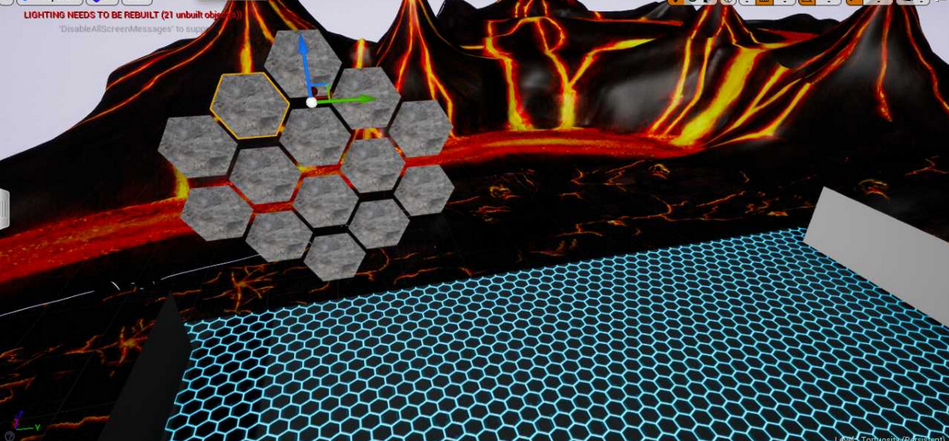
VR Adaptation
Virtual reality quiz show.
Players participate in a single player version of the web app within a 3D VR world.
Very early stages, development within the VR adaptation will increase over the next few weeks.

Slide 11
What’s Next?
Adding player icons to the game board is the next gameplay feature focus. Alongside allowing players to vote for a question, this way students have more control over the questions they answer.
The next design focus is reworking the website layout and overall design. The design at the moment feels a bit dull and needs some life added to it.
VR adaptation development is another big focus during the next sprint.

Slide 12
https://tortuositymmu.firebaseapp.com/

